Slide 1
PYSINDY PREBIOTIC CHEMISTRY SUMMER AND FALL 2021
AYAN DEEP HAZRA

Slide 2
WHAT IS PYSINDY?
Py-Sindy is a python package for the sparse identification of nonlinear dynamics from data.
Allows one to generate a system of differential equations for n species depending on a fixed amount of values.
Can forward simulate generated DE’s to test the physical relevance and reliability of equations.

Slide 3
BEGININGS OF PROJECT, GOAL
The project was initially seeking to use RING to categorically and systematically classify the types of glycine and alanine reactions that can occur given a set of constraints, such as polymer length, number of active centres, etc.
We realized that there were multiple problems with using RING.
Switched to using PYSINDY instead. Would start with a “true” model, i.e. lab generated results, try to simulate over a given timeframe, use the datapoints from the generation to try and recover the system. Would also try to add in noise over the simulation data, to see where and how the model falls apart.
Idea being, this might give us some insight on how real-life data collection is affected by noise and disturbance.

Slide 4
APPROACH 1
This approach would take the original model and simulate different starting conditions and analyze the dynamics of the system till a end point, then it would repeat that for several random starting conditions. It would then combine all this data in a large matrix and feed it into the model, which would generate what the expected system is.
The first approach did not yield good recovery of the model, and this seems to be because Py-Sindy performs much better when a lot of a the change and non-linearity in the system is recorded much better than the linear data.

Slide 5
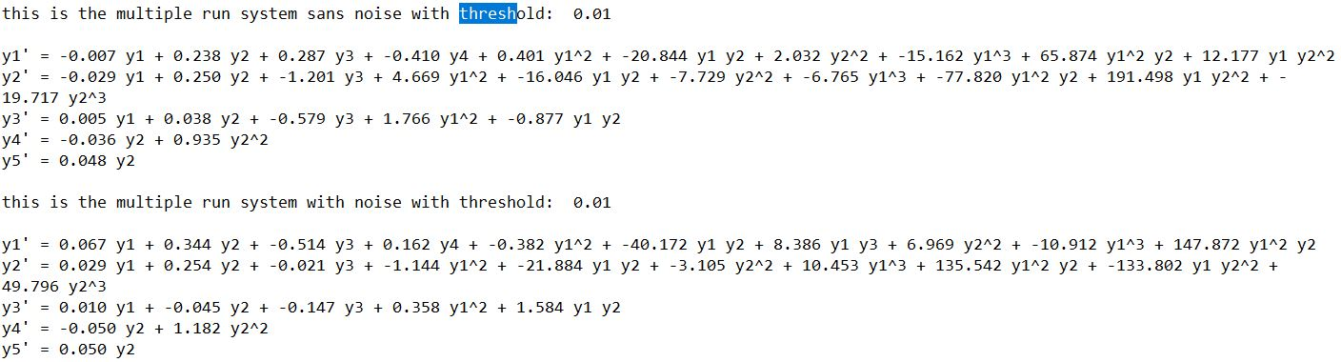
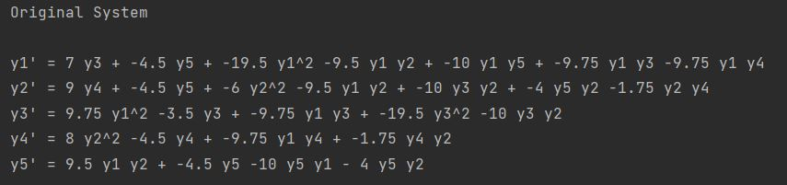
EXAMPLE 1
Recovery is pretty bad, neither the expected terms’ coefficients match, nor do the number of expected terms match, some are missing and some are incorrectly added in the recovered vs the original.

Slide 6
APPROACH II
This approach works better because the data collection is skewed to the part of the system where the majority of change occurs.
Random datapoints are the only inputs of the data, but they’re not a series of runs, just individual datapoints based on the initial starting conditions.
In general, is able to recover system much better, both with and without noise. Depending on the degree of noise and the frequency of sampling, it could be several orders of magnitude better.

Slide 8
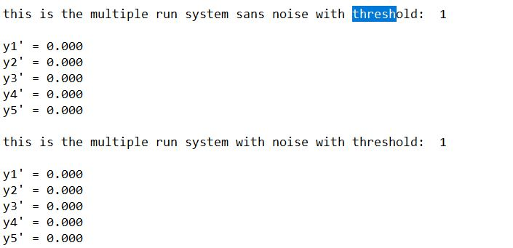
Threshold = 10^0

Slide 9
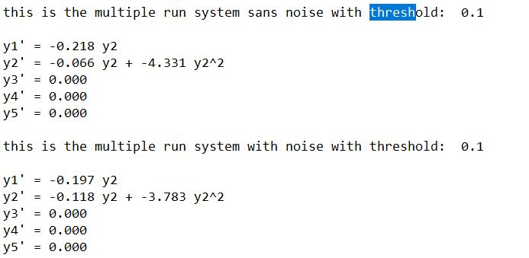
Threshold = 10^-1

Slide 10
Threshold = 10^-2

Slide 11
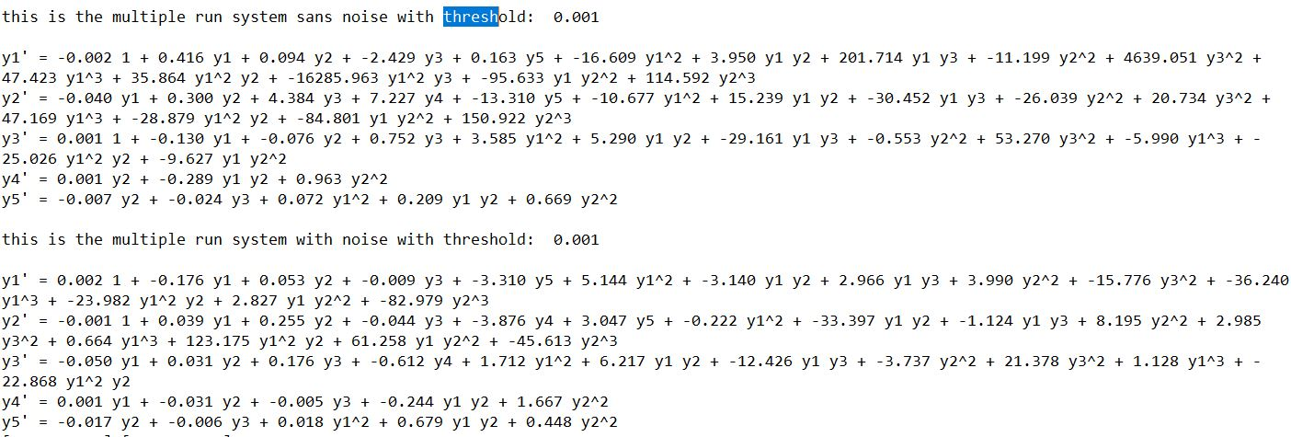
Threshold = 10^-3

Slide 12
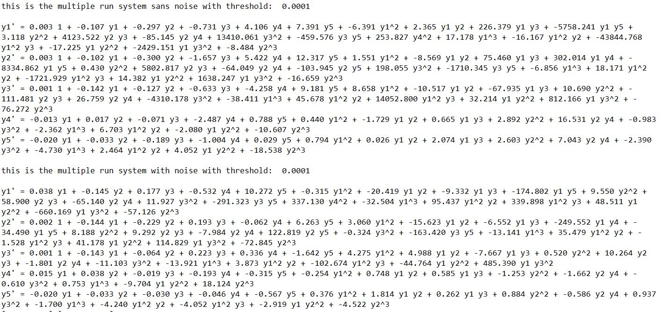
Threshold = 10^-4

Slide 13
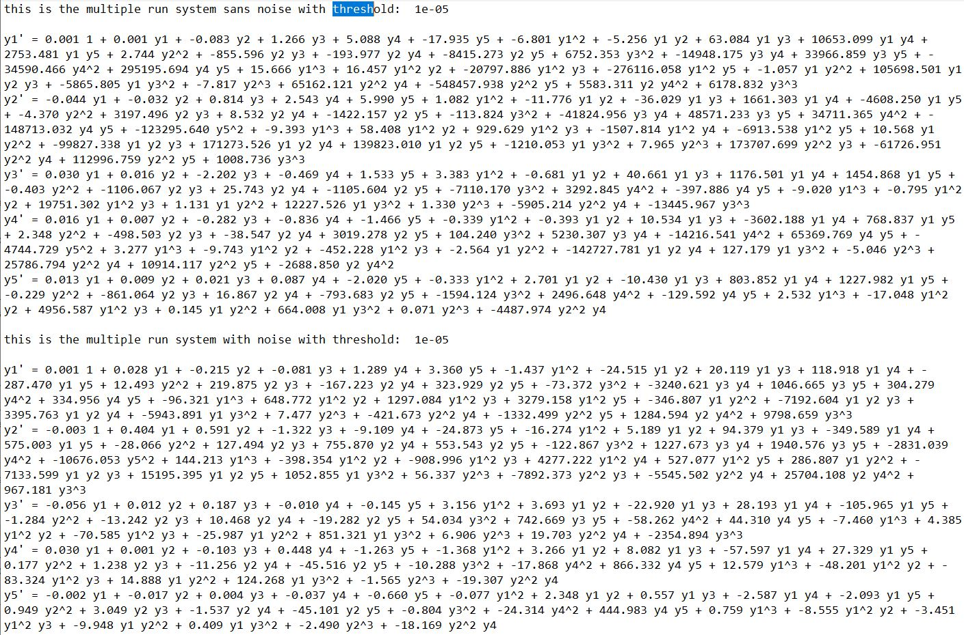
Threshold = 10^-5

Slide 14
Forward simulation
Bugs, not able to exclude negative concentrations yet
Will have to keep working on it

Slide 15
BACKGROUND
Concentrations measured as a percentage of 0.1M. For instance, 90-10 Gly-Ala means 0.09M of Gly and 0.01M of Ala.
Original Model simulates various starting IC’s.
Recovered Model (using SINDY) does the same.
Because recovery is very good, the plots are (for the most part) identical.
Ignore Y0 plots, time vs time.

Slide 16
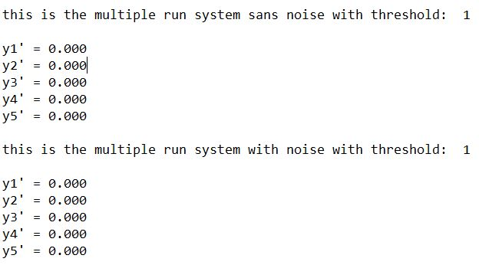
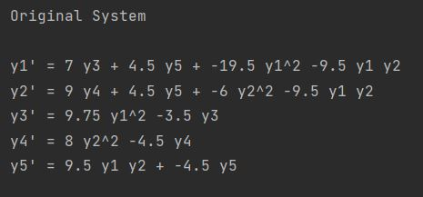
Threshold = 10^0

Slide 17
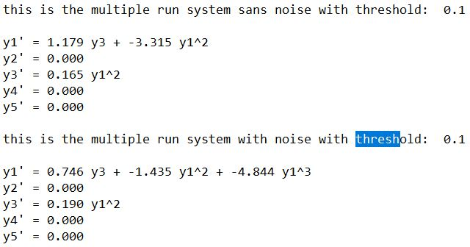
Threshold = 10^-1

Slide 18
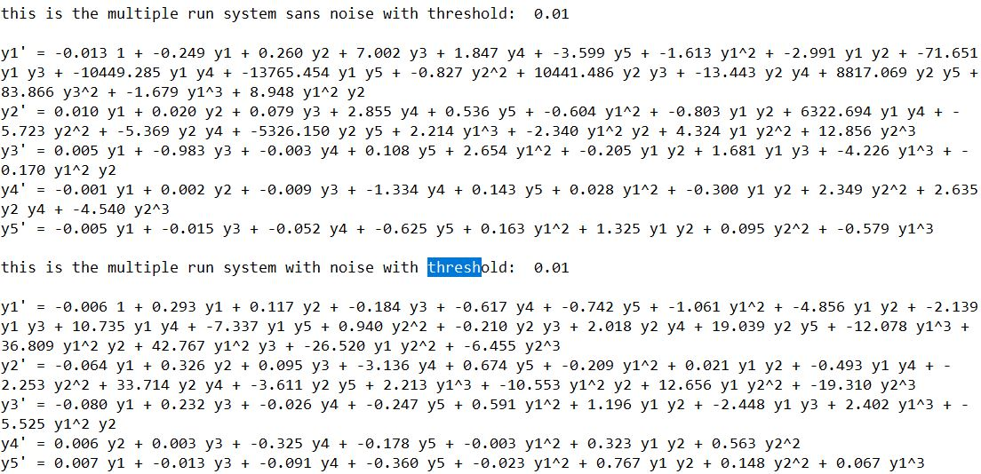
Threshold = 10^-2

Slide 19
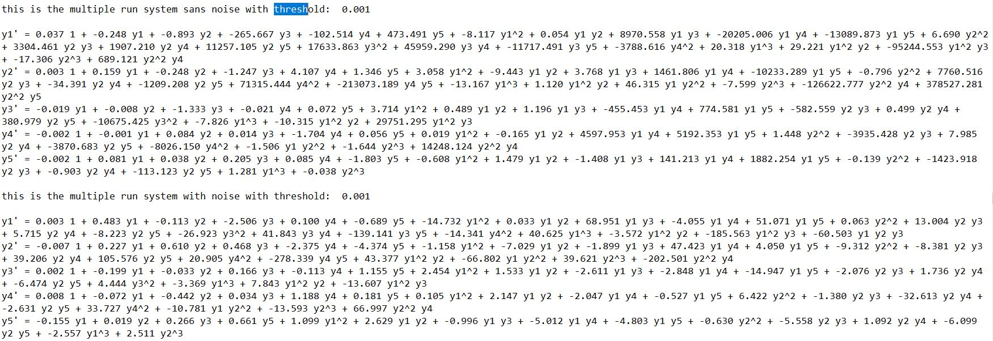
Threshold = 10^-3

Slide 20
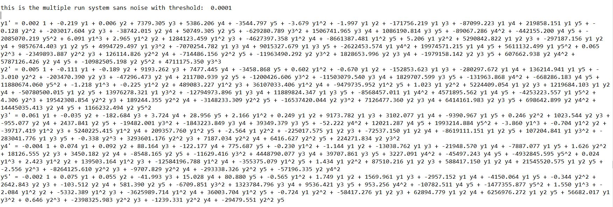
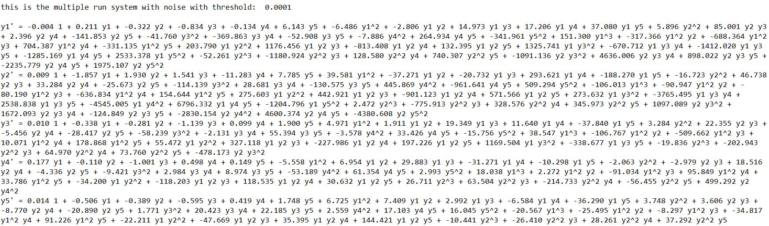
Threshold = 10^-4

Slide 21
Forward simulation
Using Siddharth’s suggestions
Will have to keep working on it

Slide 22
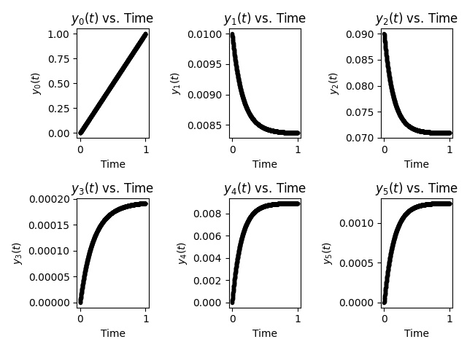
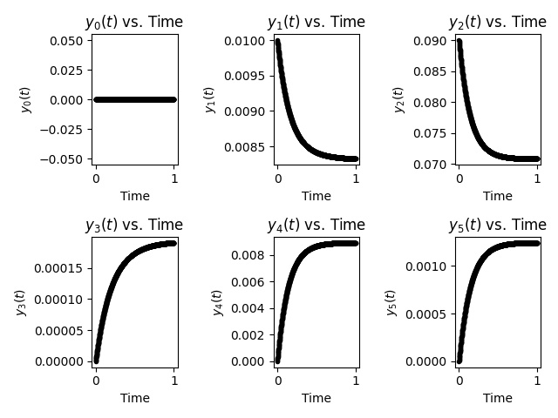
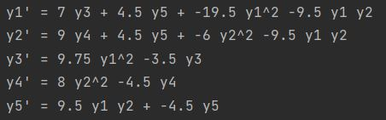
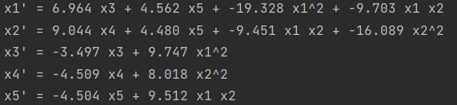
10-90 (g+a->gg+aa+ga/ag) initial conditions for simulation
Y1->G
Y2->A
Y3->GG
Y4->AA
Y5
->GA/AG
ORIGINAL MODEL
PYSINDY RECOVERED MODEL

Slide 23
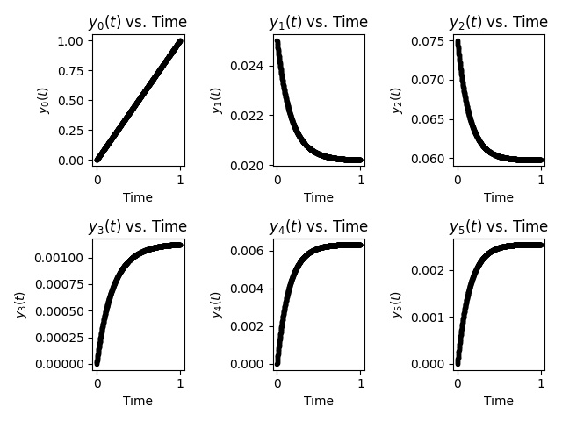
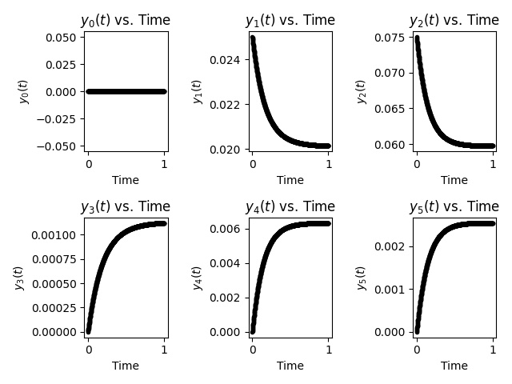
25-75 initial conditions for simulation GLYCINE TO ALANINE
Y1->G
Y2->A
Y3->GG
Y4->AA
Y5
->GA/AG
ORIGINAL MODEL
PYSINDY RECOVERED MODEL

Slide 24
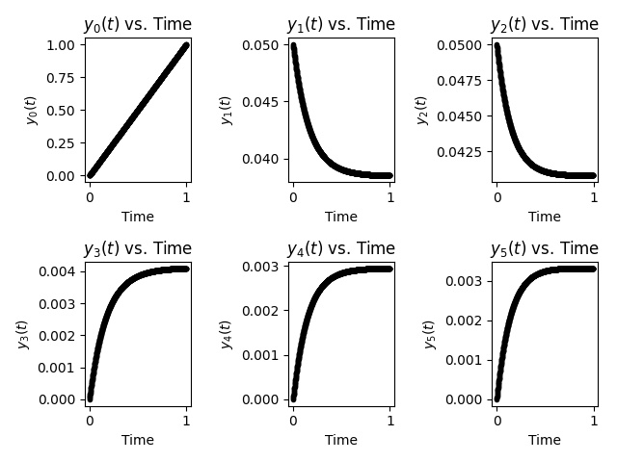
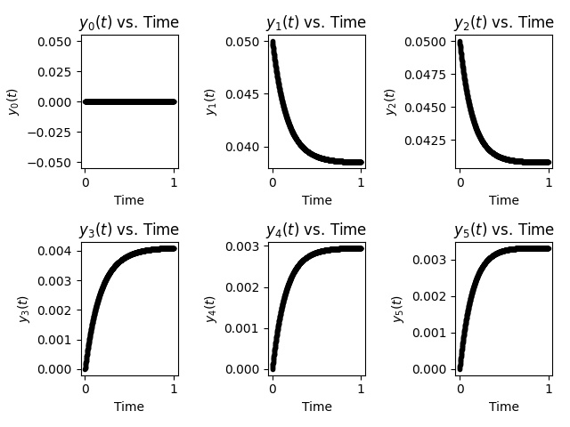
50-50 initial conditions for simulation GLYCINE TO ALANINE
Y1->G
Y2->A
Y3->GG
Y4->AA
Y5
->GA/AG
ORIGINAL MODEL
PYSINDY RECOVERED MODEL

Slide 25

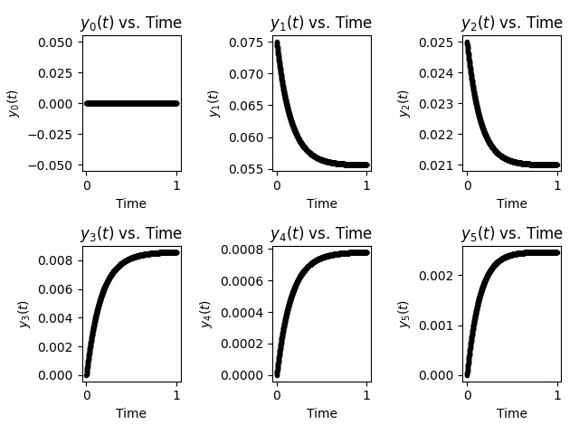
75-25 initial conditions for simulation GLYCINE TO ALANINE
Y1->G
Y2->A
Y3->GG
Y4->AA
Y5
->GA/AG
ORIGINAL MODEL
PYSINDY RECOVERED MODEL

Slide 26
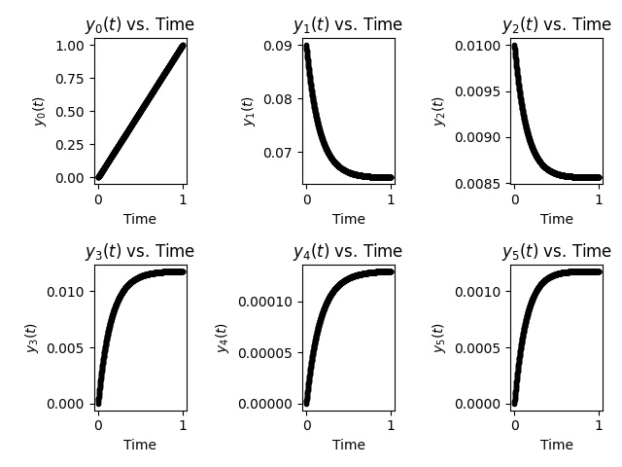
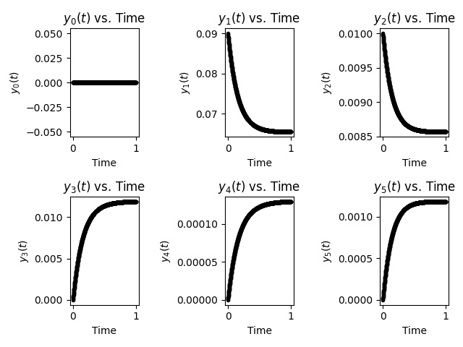
90-10 initial conditions for simulation GLYCINE TO ALANINE
Y1->G
Y2->A
Y3->GG
Y4->AA
Y5
->GA/AG
ORIGINAL MODEL
PYSINDY RECOVERED MODEL

Slide 27
FOR NEXT TIME
Work in noise addition as before.

Slide 28
BACKGROUND
Concentrations measured as a percentage of 0.1M. For instance, 90-10 Gly-Ala means 0.09M of Gly and 0.01M of Ala.
Original Model simulates various starting IC’s.
Recovered Model (using SINDY) does the same.
Because recovery is very good, the plots are (for the most part) identical.
Ignore Y0 plots, time vs time.

Slide 29
Changes from last time
Incorporated noise into data recovery.
Simulated and compared noise recovery and no-noise recovery for several instances of standard deviations and # of timepoints.
Made a plot of what combinations work favourably.

Slide 30
TIMEPOINTS
t_span = np.arange(0, 2, 0.0002)
Changed the gap to allow for different frequencies of data collection. Smaller values indicated more collection, larger 3 of timepoints.
Start and end was always 0 and 2. Reason being that the curve flattened around 2 almost always.

Slide 31
ERROR CALCULATION
We calculate the difference of each coefficient in the noise recovered matrix vs the no-noise recovered matrix. We add the absolute value of each term and divide the whole with the sum of the absolute coefficients of the no-noise matrix. We then calculate a error ratio which determines the viability of a particular run with set standard deviation and # of timepoints.

Slide 32
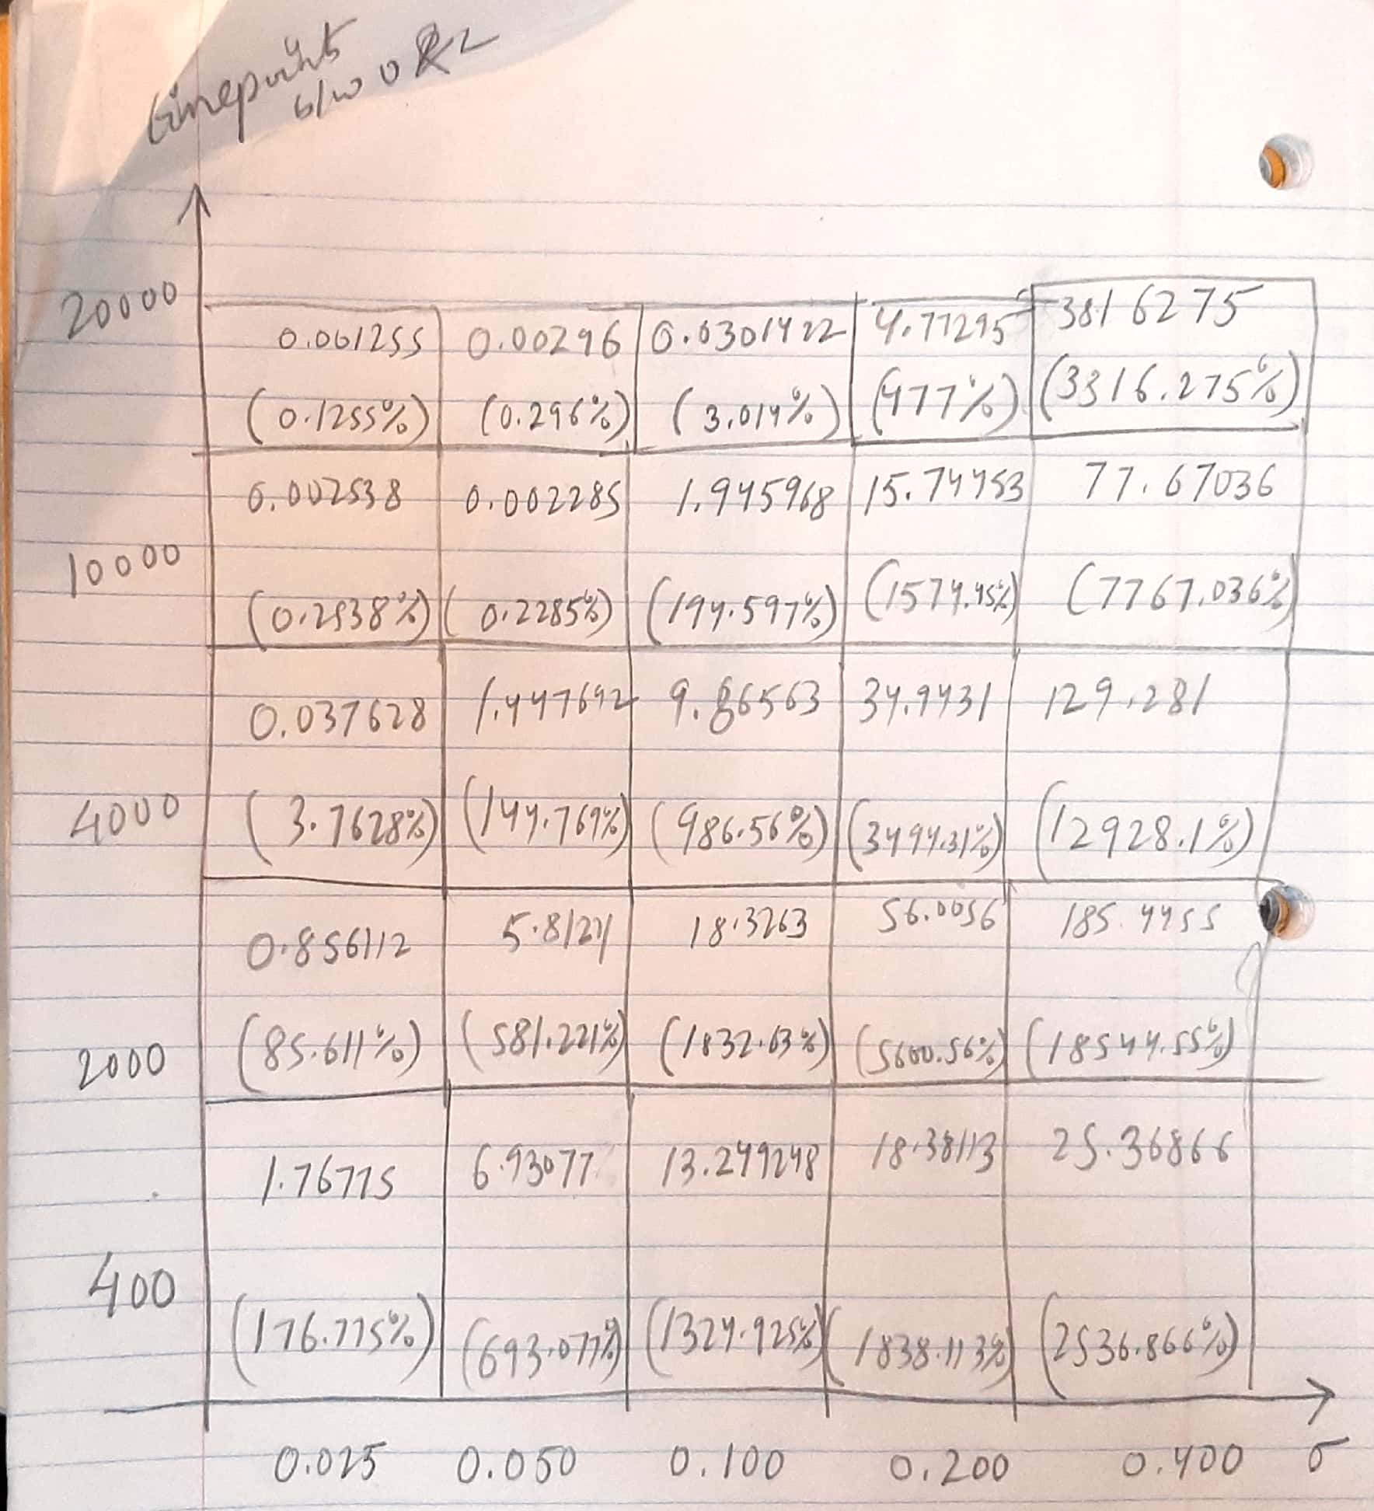

Slide 34
BEST RUN

Slide 35
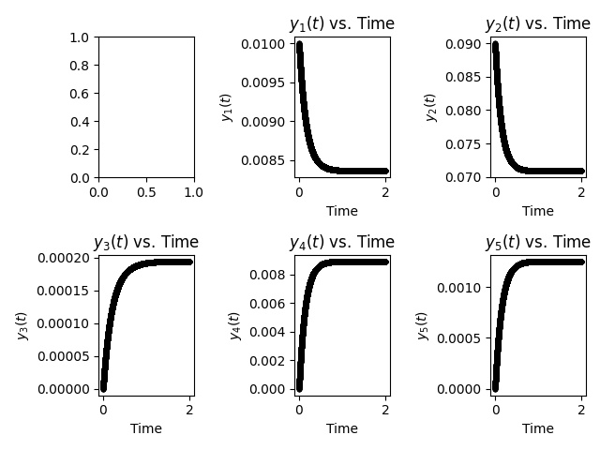

10-90 (g+a->gg+aa+ga/ag) initial conditions for simulation
Y1->G
Y2->A
Y3->GG
Y4->AA
Y5
->GA/AG
NO-NOISE RECOVERED MODEL
NOISE RECOVERED MODEL

Slide 36
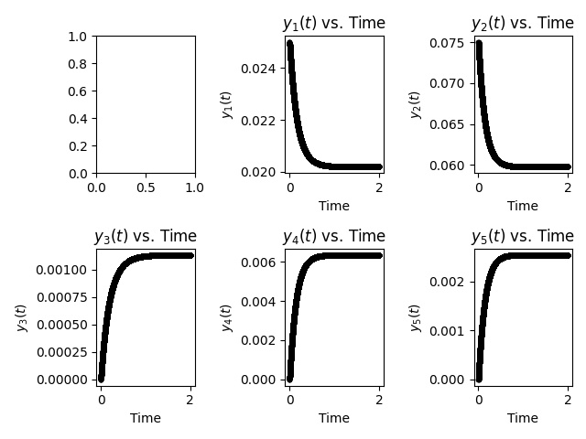

25-75 (g+a->gg+aa+ga/ag) initial conditions for simulation
Y1->G
Y2->A
Y3->GG
Y4->AA
Y5
->GA/AG
NO-NOISE RECOVERED MODEL
NOISE RECOVERED MODEL

Slide 37
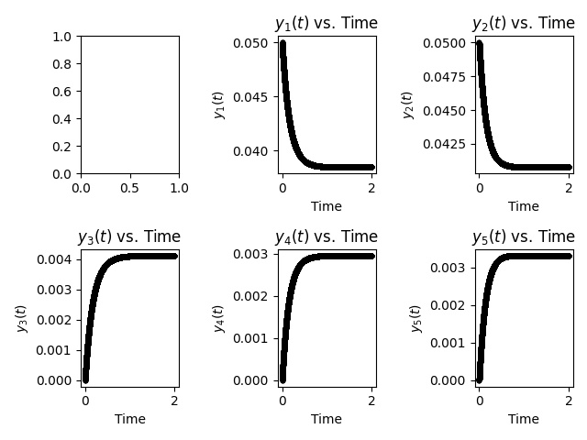

50-50 (g+a->gg+aa+ga/ag) initial conditions for simulation
Y1->G
Y2->A
Y3->GG
Y4->AA
Y5
->GA/AG
NO-NOISE RECOVERED MODEL
NOISE RECOVERED MODEL

Slide 38
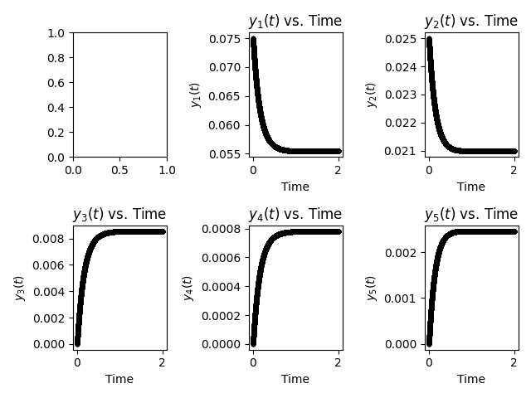

75-25 (g+a->gg+aa+ga/ag) initial conditions for simulation
Y1->G
Y2->A
Y3->GG
Y4->AA
Y5
->GA/AG
NO-NOISE RECOVERED MODEL
NOISE RECOVERED MODEL

Slide 39
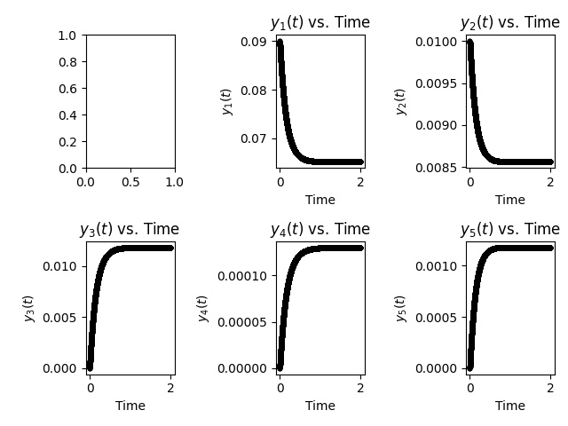

90-10 (g+a->gg+aa+ga/ag) initial conditions for simulation
Y1->G
Y2->A
Y3->GG
Y4->AA
Y5
->GA/AG
NO-NOISE RECOVERED MODEL
NOISE RECOVERED MODEL

Slide 40
FOR NEXT TIME
Work in noise addition as before.

